Slide 1


PHÂN TÍCH ĐỊNH LƯỢNG
NHÓM 16
Giảng viên : HUỲNH NAM

Slide 2

Team Members
Phan Văn Toàn
Lý Anh Khoa
Ngô Hoài Thanh
Nguyễn Chí Thanh
Lương Ngọc Thật

Slide 3
Theme
ANALYSIS OF CUSTOMER SEGMENTS IN NORTH AMERICA
80%
70%
North America

Slide 4
PRESENTATION CONTENTS
INTRODUCE AND DESCRIBE THE IMPORTANCE OF THE TOPIC.
SOLUTION DESIGN AND MEASURES.
DASHBOARD DESIGN.
ABOUT THE ADVENTUREWORK DATABASE.
DESIGN USAGE DATA
DATA VISUALIZATION
IDEATION AND PLATFORM SELECTION

Slide 5


Adventure Works Cycles is looking to expand its market share by focusing on sales activities to its most important customers.
AdventureWorks at a Glance
ADVENTUREWORK DATABASE
The AdventureWorks Illustrated Database is set on the data of 1 fictional company called Adventure Works Cycles.

Slide 6
DESCRIBE THE IMPORTANCE OF THE TOPIC
1. POSE A BRIEF PROBLEM
2. RESEARCH OBJECTIVES
The topic raises the important issue of understanding the diversity and transformation of the consumer market in North America.
Identify priority customer groups Provide insights into customer groups Optimizing marketing strategy and serving customers Profit creation and added value
This becomes even more urgent in the context of fierce competition and constant changes in today's consumer markets.
In summary, customer segmentation in North America aims to optimize management, access, and customer service, which in turn brings great benefits to businesses operating in this region.

Slide 7

3. The importance of research
Mastering the consumer market Optimizing business strategies Enhance customer experience Optimizing outreach and marketing costs Creating added value and development opportunities
4. Application of the topic
The topic brings many important applications
Outreach and marketing strategies Manage resources and budgets

Slide 8
PLATFORM IDEAS AND CHOICES
1. Brainstorm
Our team's project is focusing on analyzing customer segments in North America, using the AdventureWork2022 database.
Group customers by North America region Analysis by time of last purchase Identify priority audiences This project promises to bring important information
2. Choose a technology platform
Data visualization with Power BI
Data Processing with Python
Processing data with SQL

Slide 9
SOLUTION DESIGN AND MEASURES
1. Using RFM analysis techniques
2. Select the appropriate and necessary measurements for the analysis
Using RFM analysis techniques to analyze North American customer segments
RFM consists of 3 main indicators
Recency (R)
Frequency (F)
Monetary (M)
.
Conclusion: Combining all three RFM measures (Recency, Frequency, Monetary) helps create a comprehensive view of customer shopping behavior. By combining them, we can create specific groups of customers and suggest appropriate marketing campaigns.
.

Slide 10
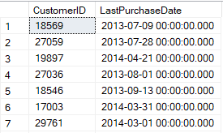
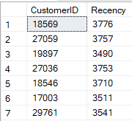
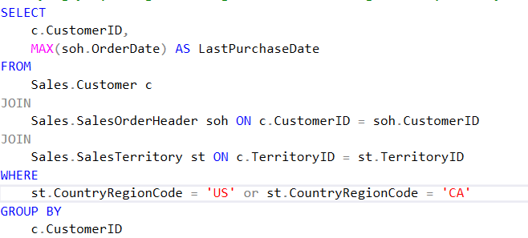
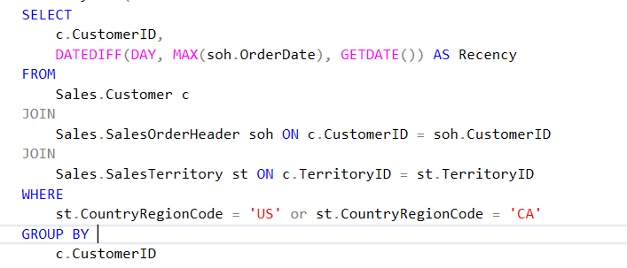
DESIGN USAGE DATA
1.Design usage data(Enterprise Data Warehouse)
- Sales.SalesOrderDetail:
- Sales.SalesOrderHeader- Sales.SalesTerritory:
- Sales.Customer:
2.Steps to conduct analysis according to RFM scale
- Recency (R):

Slide 11
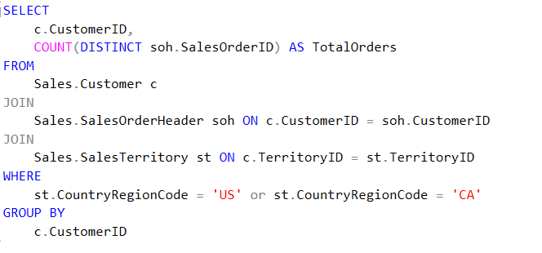
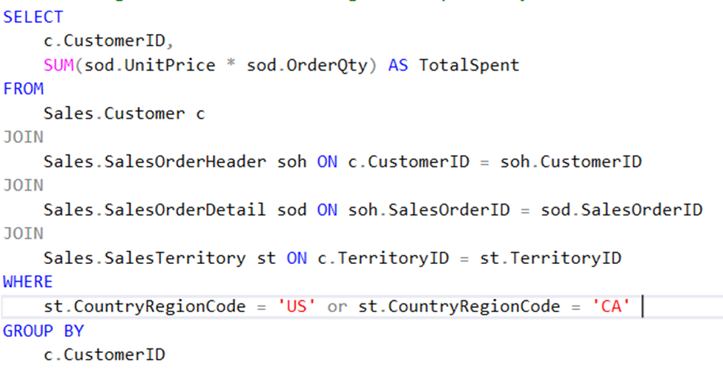

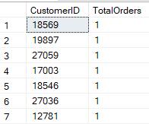
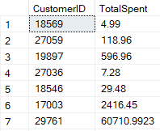
Count the number of orders each customer has in the North America region.
Calculate the total amount spent by each
North American customer.
- Frequency (F):
- Monetary (M):

Slide 12
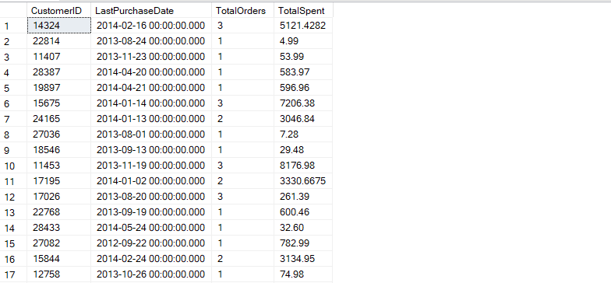
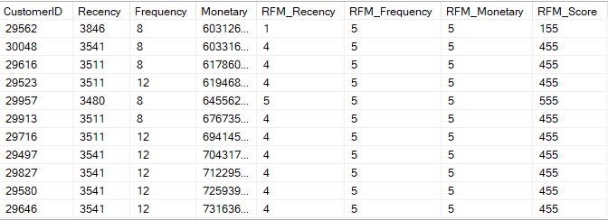

Combining the results from the above query commands is given the following table
Conducting SQL queries to calculate the RFM score,
we get the following results:

Slide 13
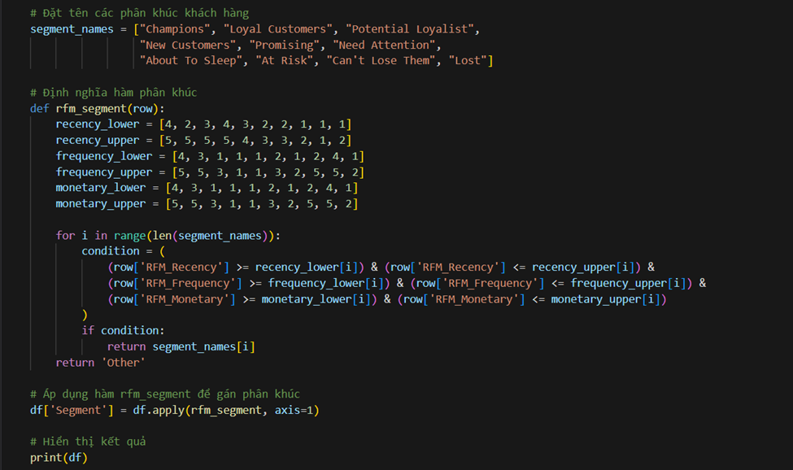
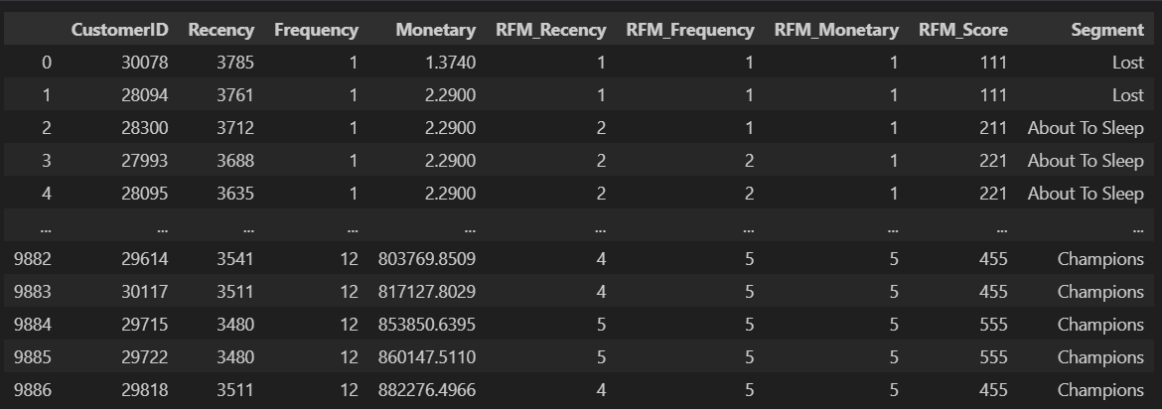

Proceed to classify customer segmentation by RFM_Score using Python:
Complete data after customer
segmentation classification

Slide 14

DASHBOARD DESIGN
Purpose: total funds spent by each customer by date, year and country
8 Table
1 Slicer
Purpose: To filter out customer segments
Purpose: To know the number of customers of each segment according to point R: last purchase time
7 Treemap
2 Card
Purpose: To know the total RFM score of the customer segment
Outline Dashboard
6 Clustered column chart
3 Card
Purpose: To know the total number of customers by customer segment
Purpose: To know the total number of visitors of the customer segment
5
Pie Chart
4 Card
Purpose: To know the percentage of customer segmentation by RFM score
Purpose: To know the total amount of money customers have spent by customer segments

Slide 15
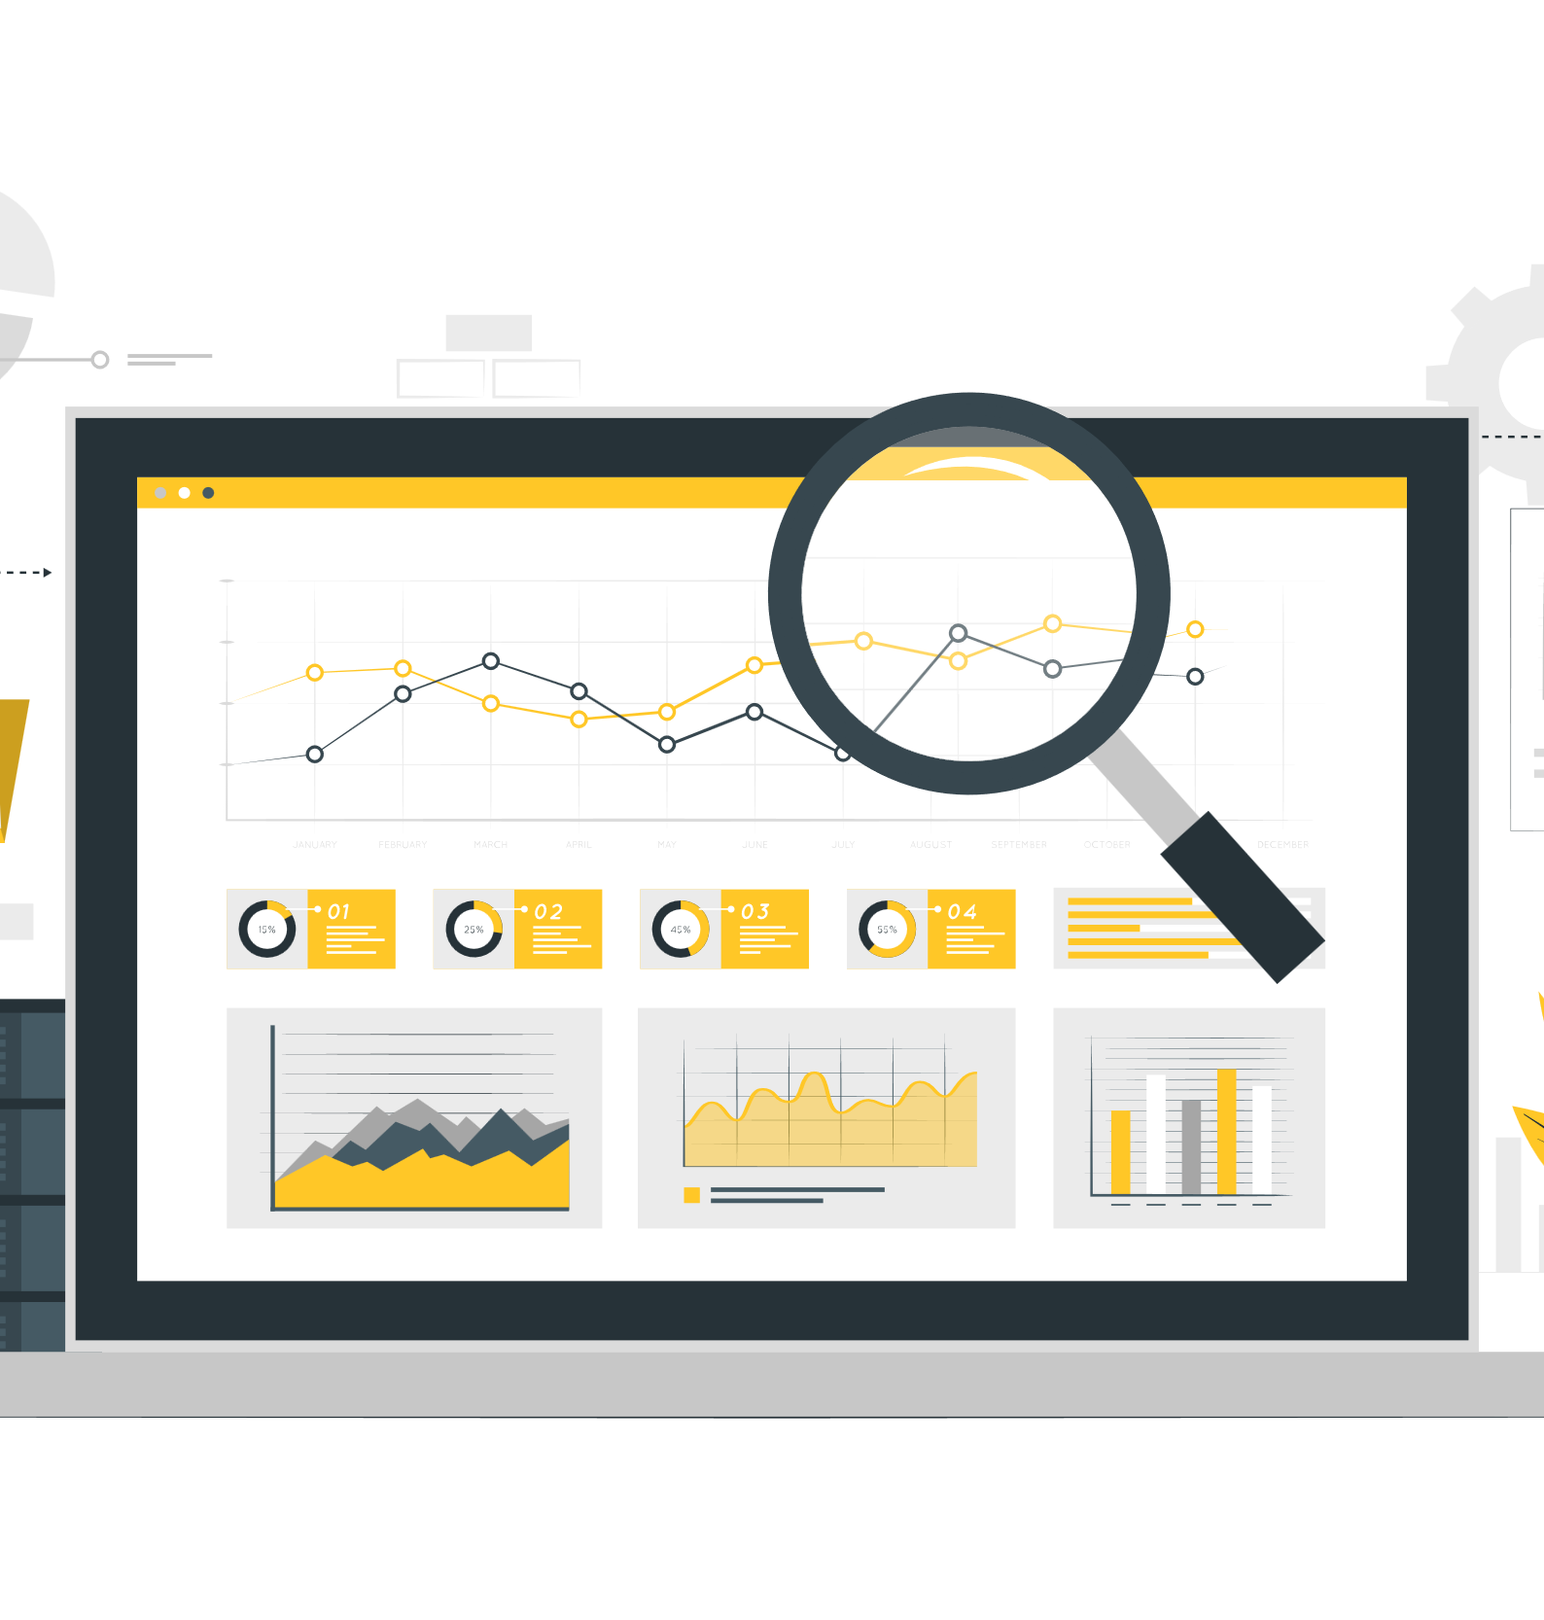
DATA VISUALIZATION
Further analyzing each customer segment, we can see that
Potential Loyalist and About To Sleep and orther are two customer segments that are likely to convert highly.
Need Attention and At Risk are two customer segments with a high likelihood of churn
Find out why these customers do not need to use the company's products or services. Provide solutions to meet the needs of these customers.

Slide 16

THANK YOU FOR LISTENING

